Slide 1
Module 2: Lesson 5 Yet Another Resource Negotiator

Slide 2
YARN (Yet Another Resource Manager)
Hadoop’s cluster resource management and application scheduling system
Provides a service and framework independent means to control cluster utilization and manage applications
Supports multitenancy where cluster resources are shared among multiple users (jobs/applications) according to well defined policies
Facilitates higher cluster utilization, whereby resources not used by one user could be made available to another

Slide 3
YARN (Yet Another Resource Manager)
Allows lower operational costs as only one cluster may be provisioned, secured, and managed while supporting a range variable workloads
Provides a service and framework independent means to control cluster utilization and manage applications
Reduces data motion; no need to move data between cluster running one Hadoop service and cluster running another
Manageable resources include CPU (vcores) and memory

Slide 4
What are the Capabilities of YARN?
Resource Management
YARN provides a centralized framework for managing resources, such as CPU and memory, across the Hadoop cluster.
It allocates resources to applications based on their needs and priorities, ensuring that all apps have the resources they need to run efficiently.
Application Scheduling
YARN schedules tasks across the cluster, taking into account resource availability, data locality, and application priorities
It ensures that tasks are scheduled to run on nodes that have the resources they need and that data is located close to the nodes that process it, reducing network overhead.
Monitoring
YARN monitors the health and performance of the cluster and provides insights into resource utilization and application performance.
This information can be used to identify and resolve problems, optimize resource allocation, and improve overall cluster performance
Flexibility
YARN is a flexible framework that can support a variety of workloads, including batch processing, MapReduce jobs, and streaming applications.
This makes it a versatile platform for big data processing and a valuable tool for organizations that need to handle diverse data processing tasks.

Slide 5
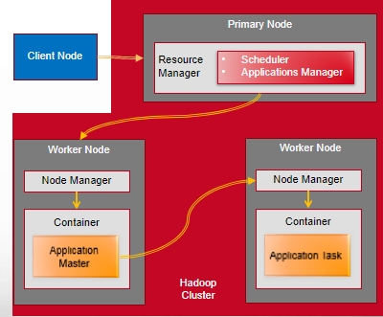
YARN Architecture Overview
The YARN service is composed of two daemon types
The primary daemon is called the ResourceManager which communicates with the client, tracks resources on the cluster, and orchestrates work by assigning tasks to NodeManagers
And the worker daemons are called NodeManagers that launch and track processes spawned on worker nodes
A client communicates with the ResourceManager to request it to run an application

Slide 6
YARN Architecture ResourceManager (Scheduler)
One of the components of the ResourceManager is the Scheduler
The Schedular is responsible for allocating resources to the various running applications
I performs no monitoring or tracking of the status of an application
It offers no guarantees about restarting failed tasks either due to application or hardware failures
The Scheduler has a pluggable resource application policy which is responsible for sharing cluster resources

Slide 7
YARN Architecture Resource Scheduling Policies
A cluster scheduler essentially has to address:
Multi-tenancy
Users launch many different applications, on behalf of multiple departments or organizations (all of which have some partial “ownership” of the cluster)
A cluster scheduler must share resources in some equitable fashion among these parties
Scalability
A cluster scheduler needs to scale to large clusters running many applications
This means that increasing the size of the cluster should improve performance without negatively affecting system latencies.
Also resource scheduling should not be optimized for any specific application type

Slide 8
YARN Architecture Resource Scheduling Policies
There are two standard modem resource scheduling policies
Fair Scheduler
Allocates resources to weighted pools, with fair sharing within each pool.
Capacity Scheduler
Allocates resources to pools, with FIFO scheduling within each pool
Different vendors default to different scheduling policies
AWS EMR => Capacity scheduler
Cloudera Hadoop => Fair Scheduler

Slide 9
YARN Architecture Resource Scheduling Policies
The Fair Scheduler is more flexible and allows for jobs to consume unused resources in the cluster
It provides resource guarantees by preempting tasks above the guarantee (fair share) based on defined weights
This makes it a good default for small to medium sized clusters.
The Capacity Scheduler is more rigid, and defines queues with resource quotas
Jobs cannot consume extra resources
This requires more configuration, tuning, and capacity planning
It's generally used on large clusters with lots of different workloads with different needs.

Slide 10
YARN Architecture ResourceManager (Applications Manager)
Another of the components of the ResourceManager is the Applications Manager
The Applications Manager is responsible for accepting client requests to execute applications
It negotiates the first container executing the application specific Application Master task
It provides the service for restarting the Application Master task on failure
Receives heartbeat indications form Node Managers to track Worker Node status and availability

Slide 11
YARN Architecture NodeManager
The NodeManager is a daemon that runs on every worker node in the cluster
Oversees Containers through there lifecycles
This includes launching containers (application tasks)
It monitors per worker node resource usage and reports this to the ResourceManager
Registers with the ResourceManager and sends heartbeats with the health status of the worker node

Slide 12
Caution, Overloaded Terms Ahead
YARN uses some common terms in uncommon ways
When most people hear “container”, they might think Docker or Kubernetes
In the YARN, it takes on a new meaning
A Container represents a collection of physical resources such as RAM and CPU cores
It is an abstraction used to bundle resources into distinct and trackable units
In effect a container is a right to use a specified amount of resources

Slide 13
Caution, Overloaded Terms Ahead
“Application” is another overloaded term
Most people think of an application as a process which executes to provide some business capability
In YARN, an application represents a set of one or more tasks that are to be executed to accomplish some overall objective
So tasks are the logical units (processes, threads) performing the work applications
An application in this context is also referred to as a type of job
For example, a MapReduce job involves the execution of some number of map and reduce tasks

Slide 14
YARN Architecture Containers
A container in YARN holds (reserves) resources on the cluster
An application in YARN comprises three parts:
1. The application client, which starts, configures and interacts with the application
2. An ApplicationMaster, associated with a container, which initiates coordinates application tasks across the cluster
3. One or more application tasks, each also associated with a container, that do the actual work

Slide 15
YARN Architecture Application Master
Neither the resource manager or the node manager controls overall progress of an application
This makes sense as we want to keep our distributed middleware (Resource Manager and Node Manager) application agnostic
So the question becomes, how is the progress of each application managed?
This is the role of the application specific and custom Application Master task
Each type of application running on Hadoop has its type of Application Master
Each running instance of an application has its dedicated Application Master instance
This instance lives in its own separate container on one of the nodes in the cluster
It is the one container (task) whose initiation is performed by the Resource Manager

Slide 16
YARN Architecture Application Master
Once initiated, an Application Master instance creates other containers (tasks) the application needs to progress
Each application’s Application Master periodically sends heartbeat messages to the Resource Manager
The Application Master oversees the execution of an application over its full lifespan…
From requesting additional containers (resources) from the Resource Manger
To submitting container release requests to the Node Manager on application completion

Slide 17
YARN Architecture Application Master
For example…
A MapReduce application consists of map tasks and reduce tasks executing in parallel across the cluster
A MapReduce application begins with the assignment of an MRAppMaster to a container
The MRAppMaster then goes on to request containers and initiate creation of map and reduce tasks

Slide 18
YARN Application Initiation Overview
Application execution consists of the following steps:
Application submission.
Bootstrapping the ApplicationMaster instance for the application.
Application execution managed by the ApplicationMaster instance

Slide 19
YARN Application Initiation Details
YARN currently defines two resource: v-cores and memory (RAM)
Each NodeManager tracks::
1. Its own local resources
2. Communicates its resource configuration to the ResourceManager
The ResourceManager keeps a running total of the cluster's available resources

Slide 20
YARN Application Initiation Details
A client program submits the application (job) to execute
The Resource Manager communicates with a Node Manager
The Node Manager allocates a container to start an application specific Application Master
The Application Master, on starting up registers with the Resource Manager
The Application Master negotiates with the Resource Manager for one or more additional resource containers
On successful allocation, the Application Master contacts Node Managers to launch the containers (and tasks)
The Node Managers allocate containers to start application specific tasks

Slide 21
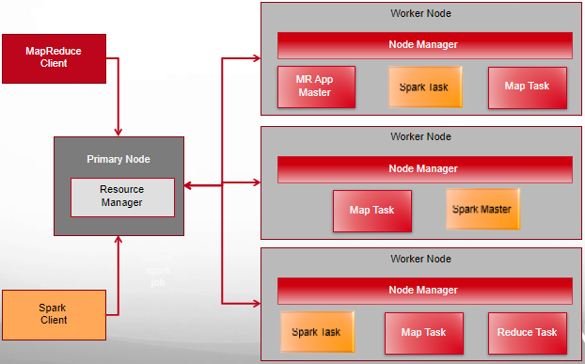
Multi-tenant Hadoop Cluster

Slide 22
Resource Manager Fault Tolerance
Realized through an Active/Standby architecture
At any point of time, one of the RMs is Active, and one or more RMs are in Standby mode waiting to take over should anything happen to the Active
The trigger to transition-to-active comes from either an admin (manual failover)
Or the integrated failover controller when automatic failover is enabled
To support automatic failover RMs embed the Zookeeper ActiveStandbyElector
This decides which RM should be the Active
When Active goes down or becomes unresponsive another RM is automatically elected to be the Active which then takes over

Slide 23
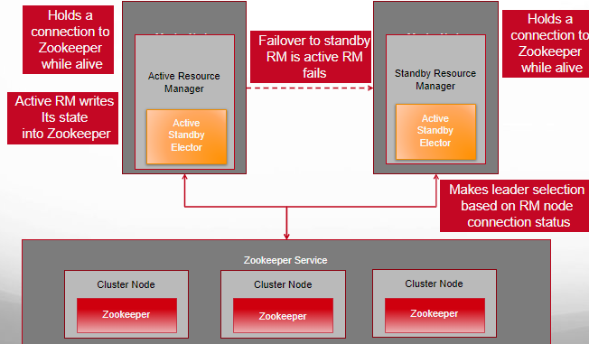
Resource Manager Fault Tolerance

